Slide 1
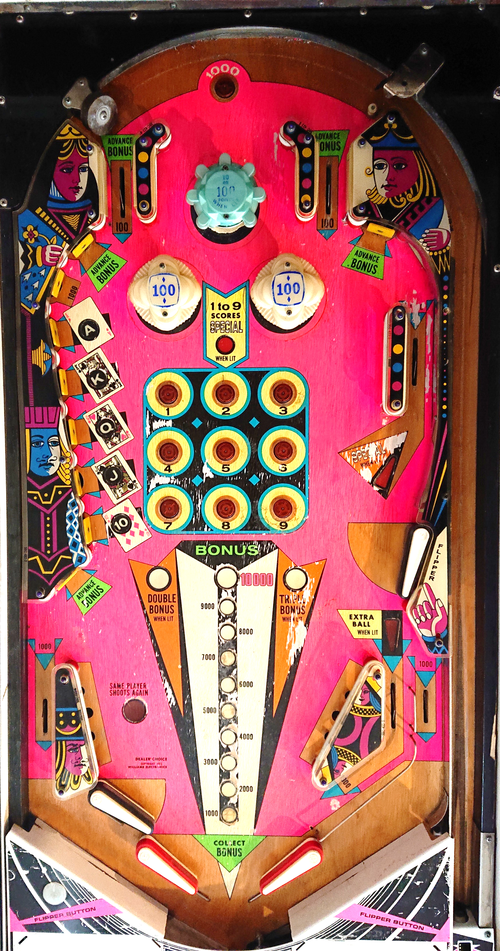
Rollover_1000
Lane_Top_Left_2
Lane_Top_Left
Top_Bumper
Lane_Top_Right
Lane_Top_Right_2
Left_Bumper
Right_Bumper
Target_ A
SPECIAL
Target_ K
Rollover_1
Rollover_3
SPECIAL_Lane_2
Left_2
Rollover_2
Target_ Q
Rollover_4
Rollover_6
Rollover_5
SPECIAL_Lane
Target_ J
Rollover_7
Rollover_9
Left_1
Target_10
Rollover_8
Double_Bonus
Triple_Bonus
Flipper_Top_Right
EB_Lane
EB
Slinghshot_Left
Slinghshot_Right
Apron

